Slide 1







Badkan
Samuel Bismuth & Dvir Barzilay

Slide 2
"Badkan" is an automated system for testing the programming tasks of students

Slide 3
There are two options to set up a task for students:
Design tests by the task author
Design tests as part of the student learning process

Slide 4
Design tests by the task author
Task author process
Setting Up Task
Setting Up Tests
Students only have to solve the task and upload it to the server.
The server will run the series of tests and the student will receive immediate feedback for his solution.

Slide 5
Design tests as part of the student learning process
The task author should only define the task.
Students process
The server will run all students' tests for each solution submission and will return immediate feedback for the solution.
Uploading Tests
Uploading Solutions

Slide 6
OUR MISSION
Effective and comprehensive learning - Students will practice writing tests.
Instant Feedback - Students will receive a grade immediately so that they can improve and correct their mistakes. This will allow them to get the most out of the task.
Saving time for the lecturer - the lecturer will not have to check all assignments manually or write tests for them.

Slide 7
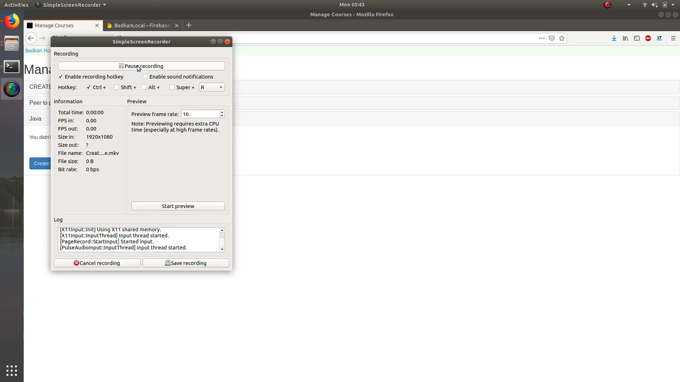

Slide 8
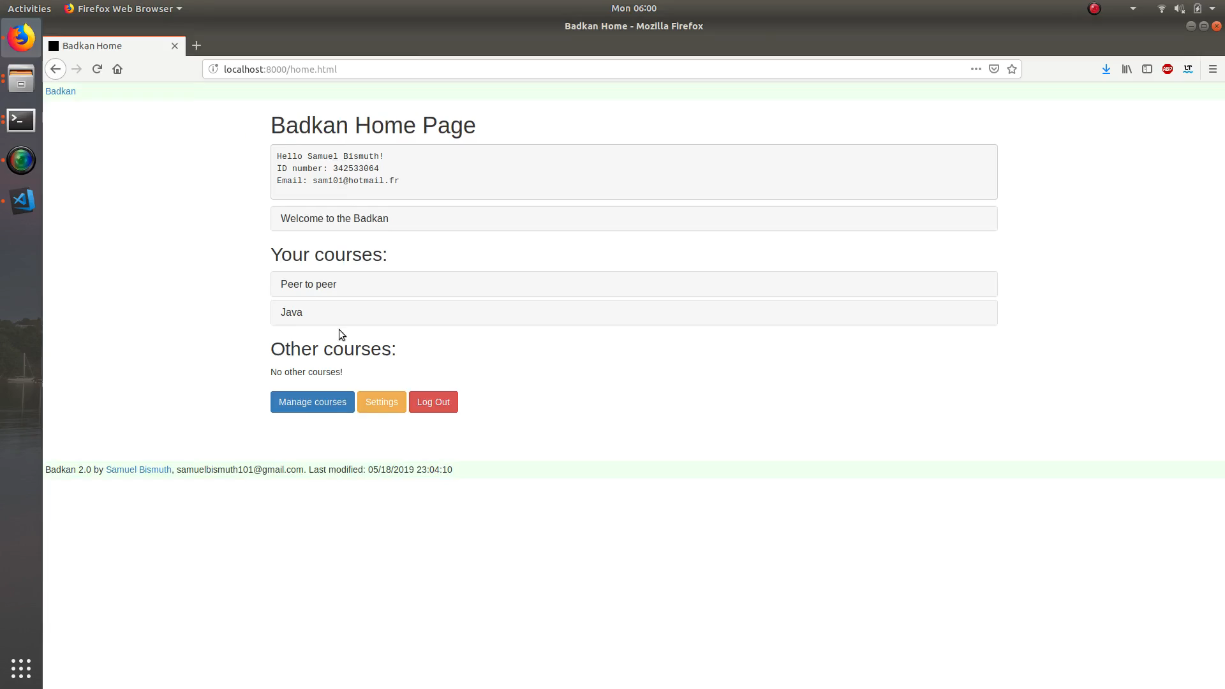

Slide 9
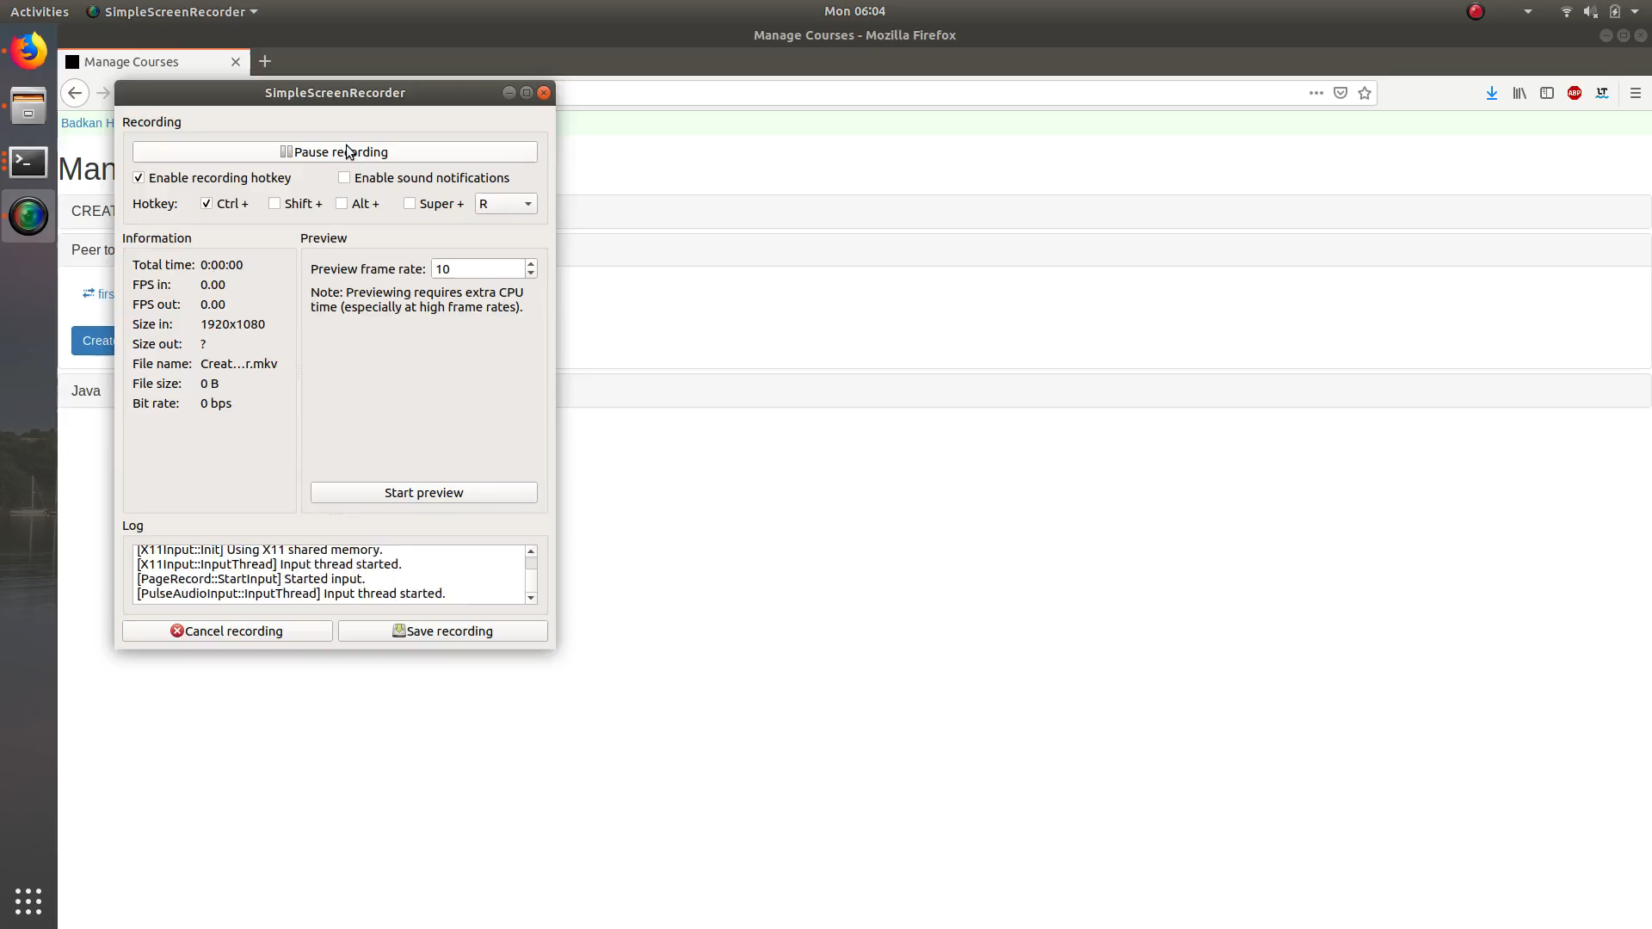

Slide 10
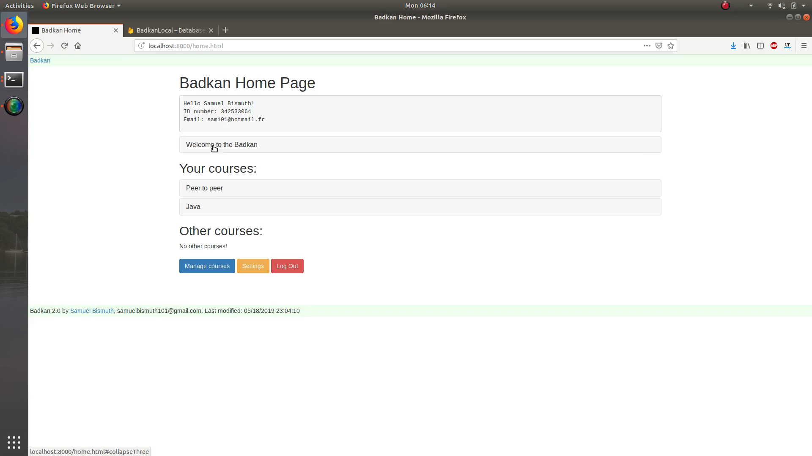

Slide 11
